Slide 1
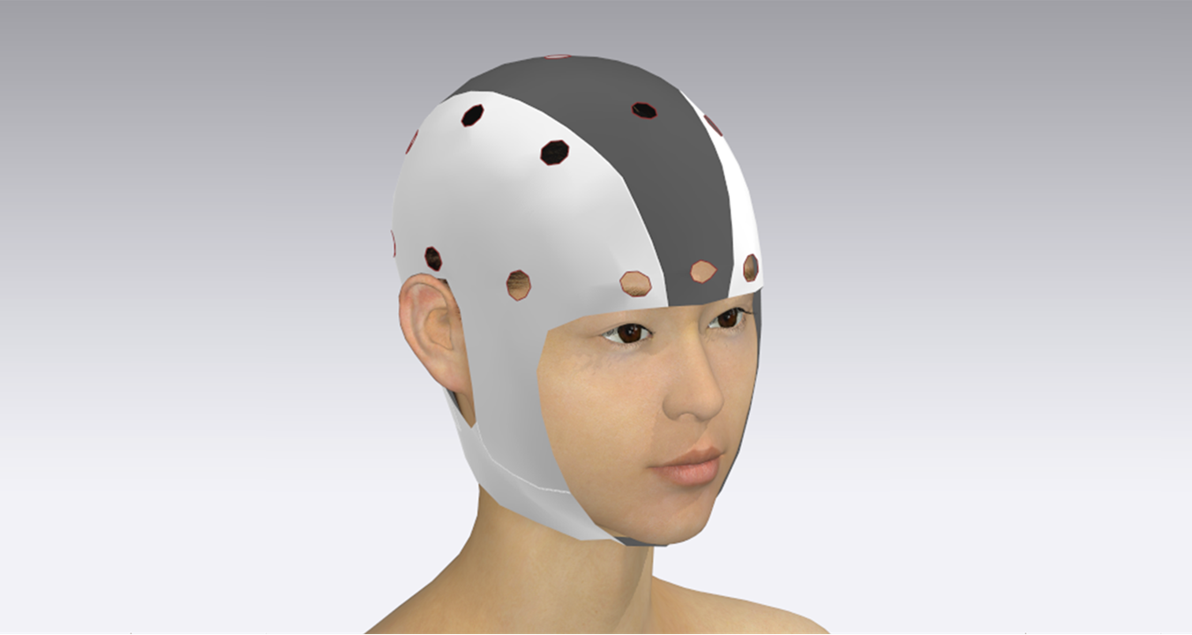

Design of real-time continuous EEG acquisition system with feedback based error correction for P300 task paradigms
Under the guidance of
Dr. N. Sriraam, RIT
Mrs. Prabhu Ravikala Vittal, RIT
Dr. Mahendra, Dept of Neurology
Project Members
Adway U Kanhere, RIT
Jigyans Kranti Mohapatra, RIT
Prajna G Hardikar, RIT
T H Greeshma, RIT
ML-FYP-2020-07

Slide 2
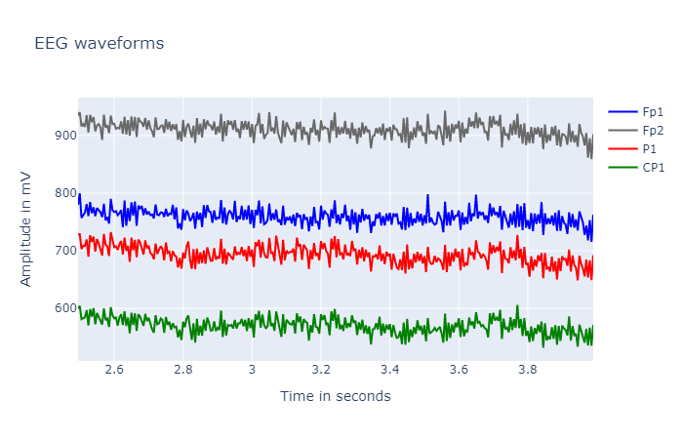
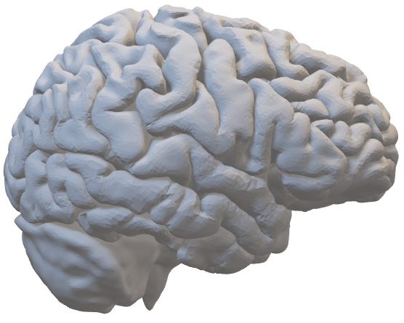
EEG and BCI
EEG refers to measuring the spontaneous electrical activity of the brain.
BCI is a technology which allows human to control the computer or any electronic devices with thought
Human brain is the most complex organ in the body and it is the centre of driving block of human nervous system.
EEG signals are majorly used in psychology and neuroscience, Clinical and psychiatric studies, diagnosing neurological disorders etc.
Electrical signals are sent to the computer which translates signals into a data which is used to control device linked to computer

Slide 3


Project Overview
Hardware
Software
Dataset selection
Signal Pre-processing
Developing a suitable model for error detection in BCI systems
EEG Cap
Version 1
Version 2
Electrode Dock
EEG Acquisition Board

Slide 4

Need For The Study
Lack of flexible modular EEG acquisition systems
Customisable hardware for custom applications
High entry costs for EEG Acquisition Systems
Comfort of subject for long duration recordings
Custom Hardware Interfacing Options

Slide 5

Hardware
Design of an EEG cap based on standard 10-20 electrode system
Selection of suitable components for the acquisition system
Design of a compact EEG acquisition circuit
Design and fabrication of PCB
Objectives

Slide 6
Product Review
Product | Company | The methodology incorporated in the product | What we implemented from the Product
Ganglion | OpenBCI | Analog Front End Bluetooth/ Wi-Fi based connectivity GUI | Analog Front End Inspiration
Ultracortex "Mark IV" EEG Headset | Open BCI | Plug in plug out Electrode system design | Section of the Electrode Dock was inspired from it
LiveAmp | Brainlatam | Multi Channel Compact EEG Acquisition System | Inspiration for cap design

Slide 7

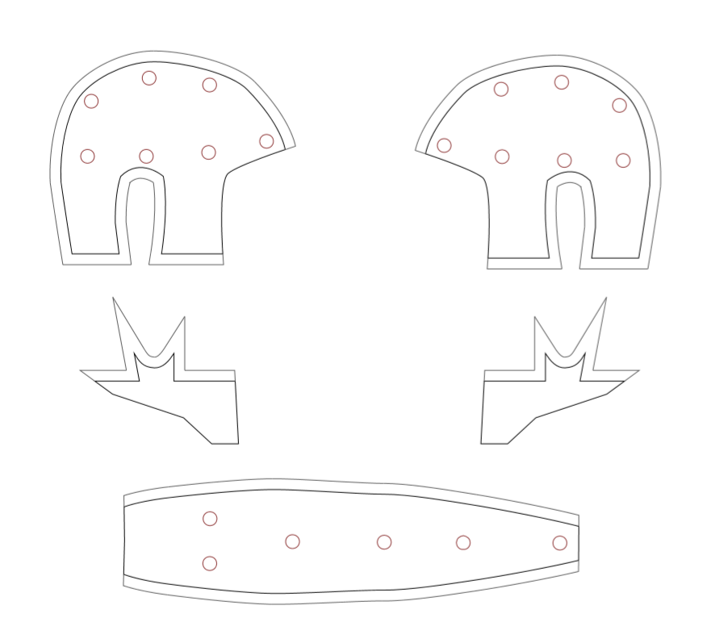
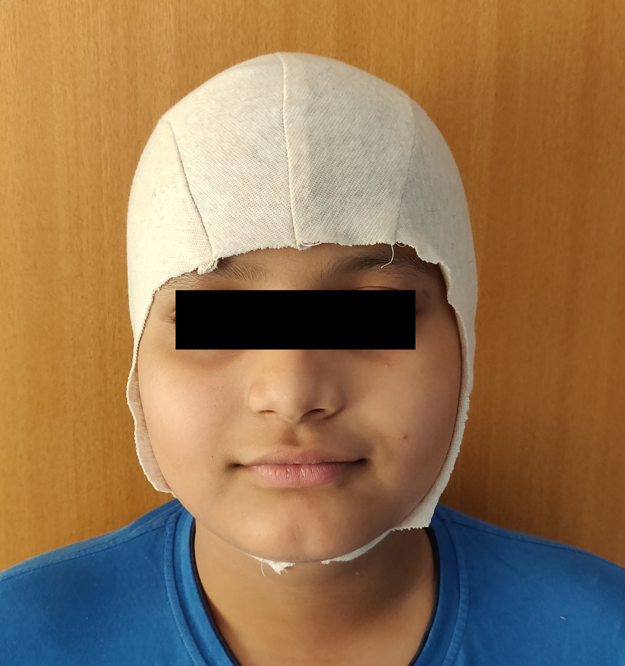
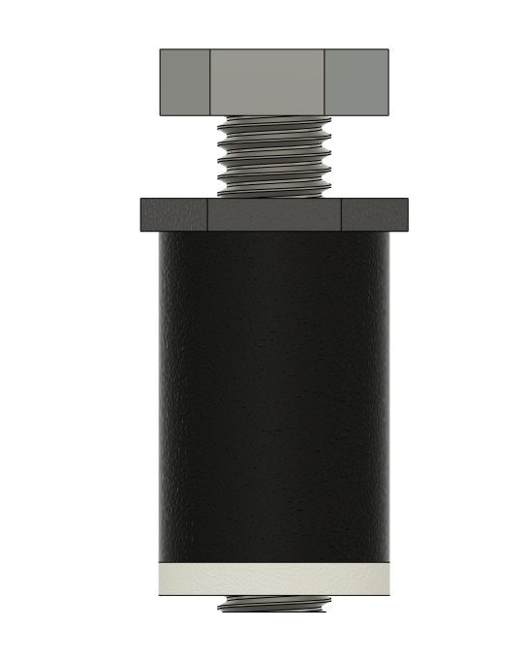
Cap Design
& Material Selection
Electrode
Dock
Fabrication
3D & 2D Design
10-20 system electrode placement
Material Selection Criteria
Softness
Elasticity
Reusability
Method to mount various electrodes to the cap
Making of the cap
Cap and Electrode Dock Design

Slide 8
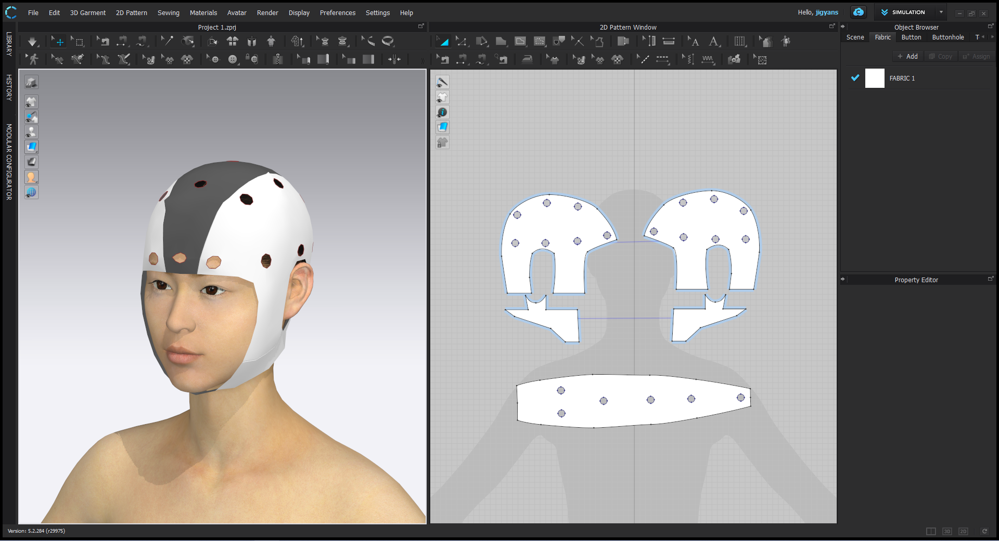
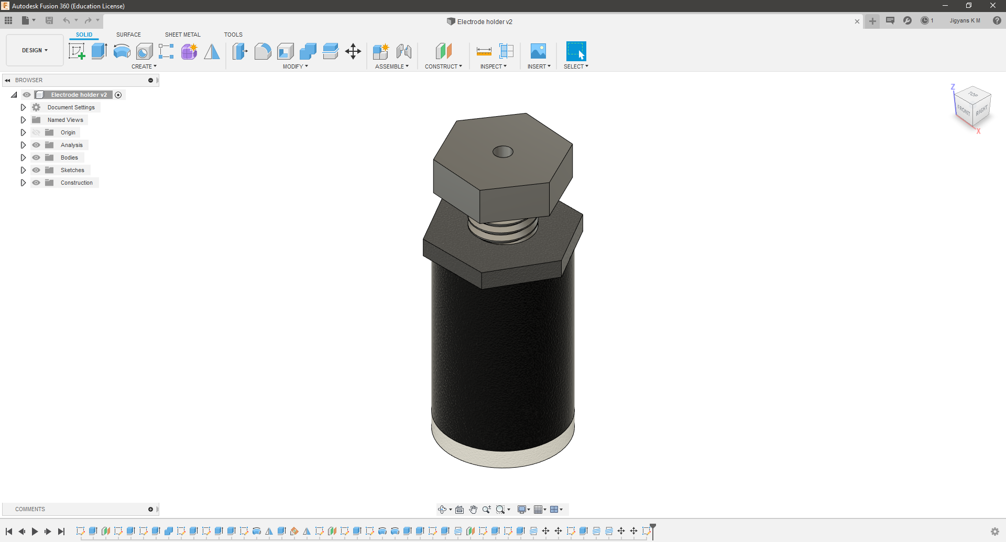
Grid System
Cap Design
Software: CLO
Electrode Dock
Software: Autodesk Fusion360

Slide 9
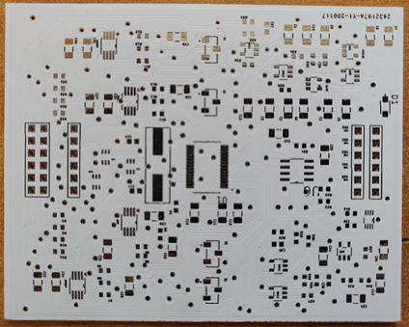
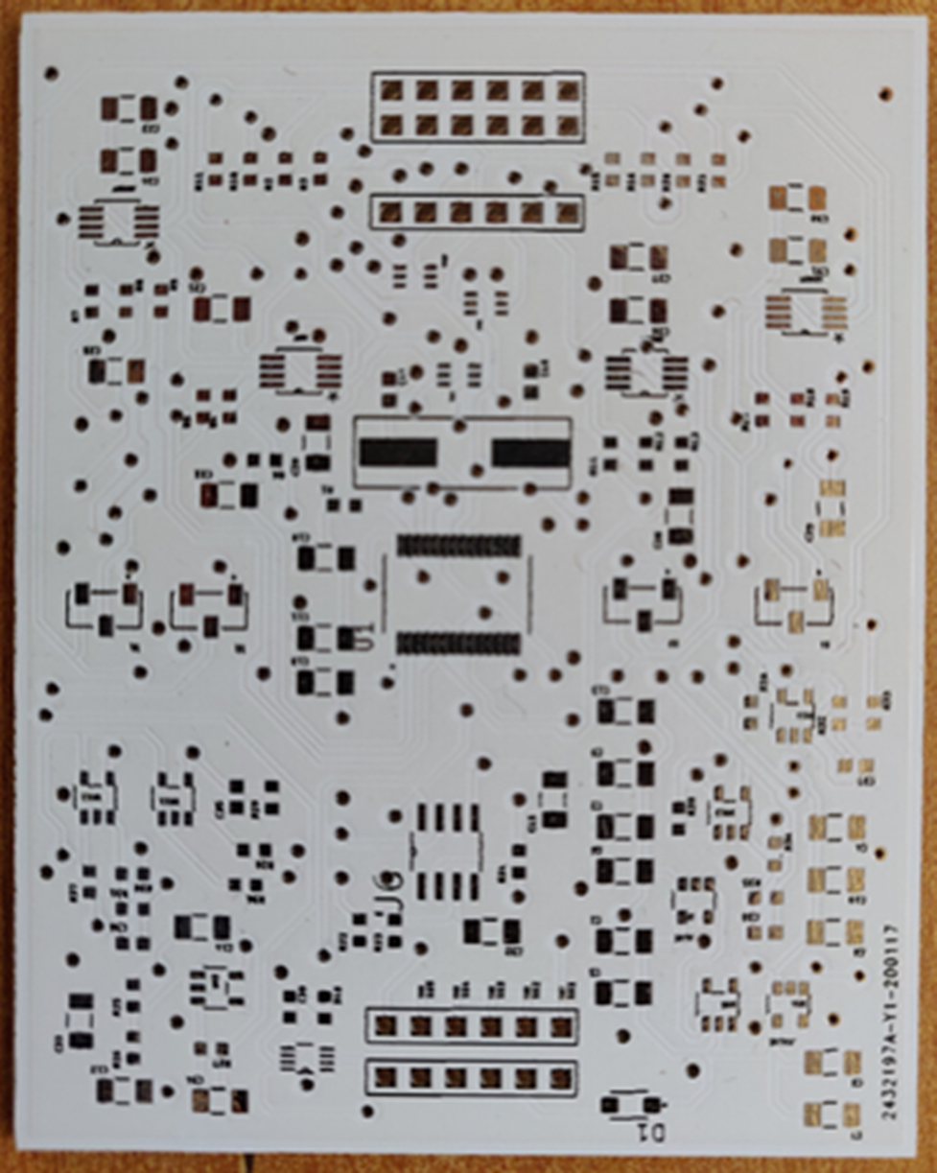
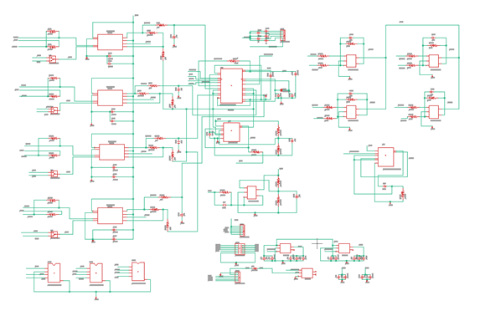
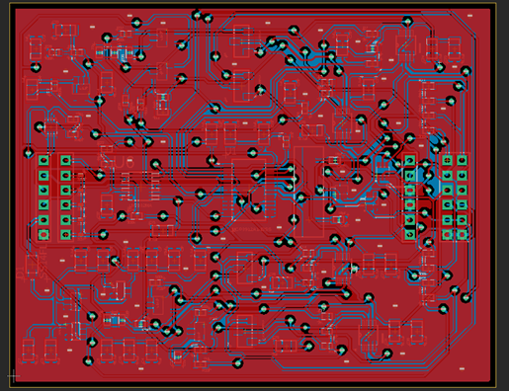
Circuit Design
Board
Design
Fabrication
Amplifier Design
Power Supply Design
Safety Circuit Design
ESD Protection
Patient Isolation
Designing a PCB from the schematics
Selection appropriate components
Fabrication of the PCB
Board Design

Slide 10
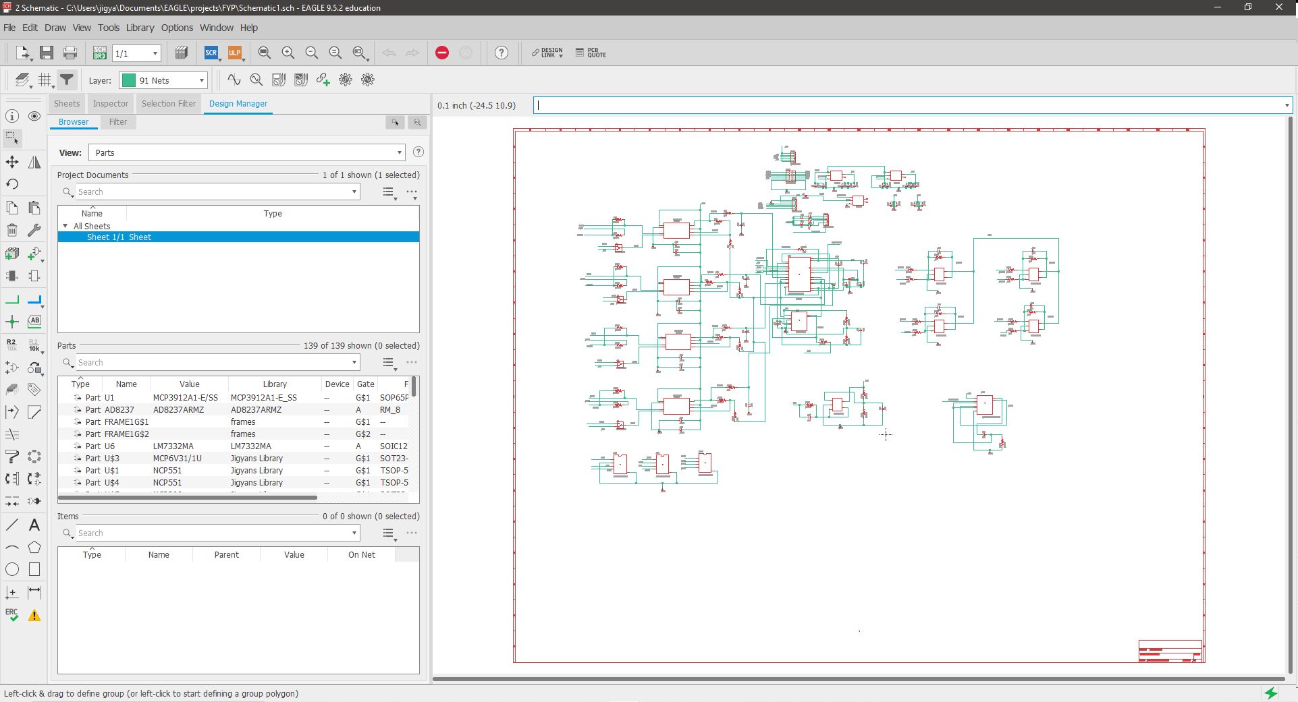
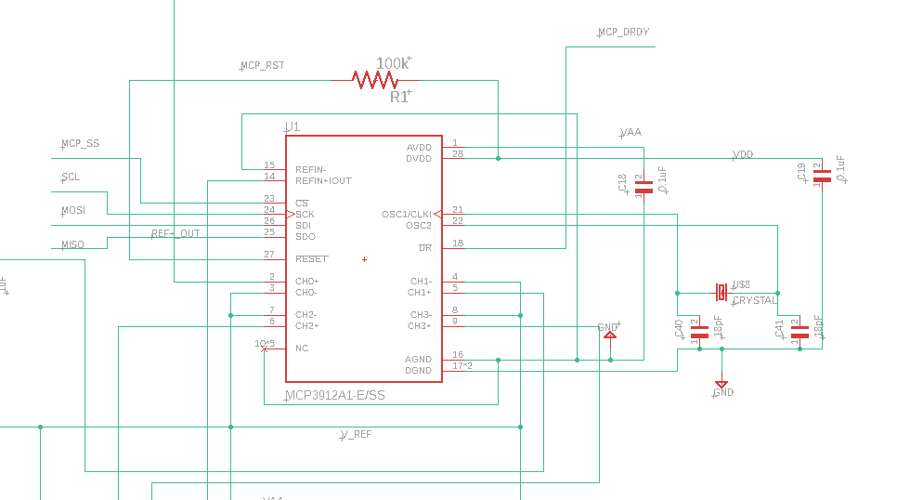
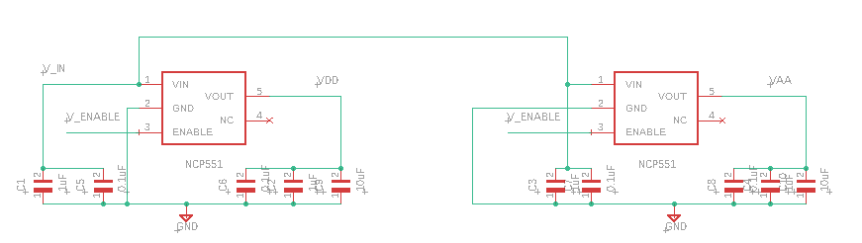
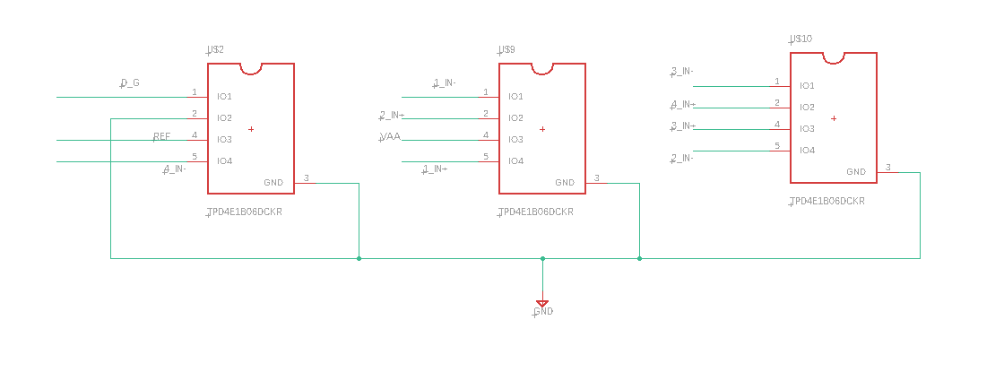
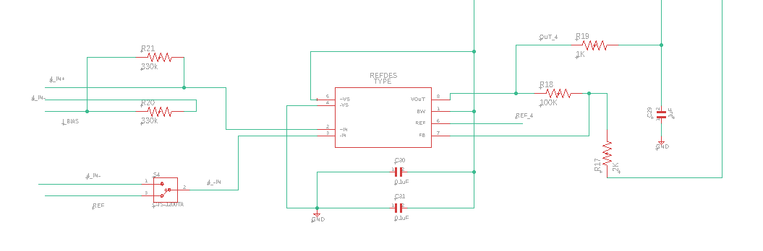
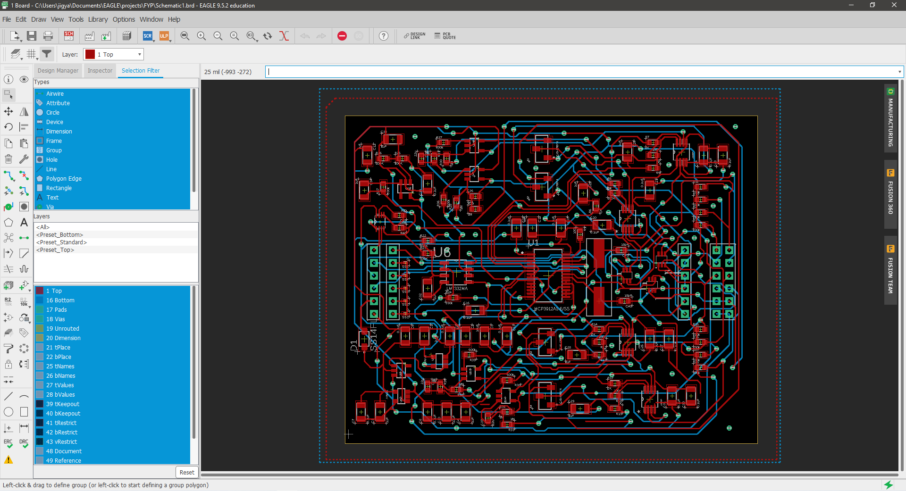
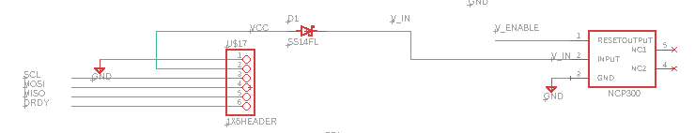
ESD Protection Circuit
Power Circuitry
ADC Circuit
Schematic Design
Software: Autodesk Eagle
ADC Pre-Amplifier
Circuit
Board Design
Software: Autodesk Eagle

Slide 11


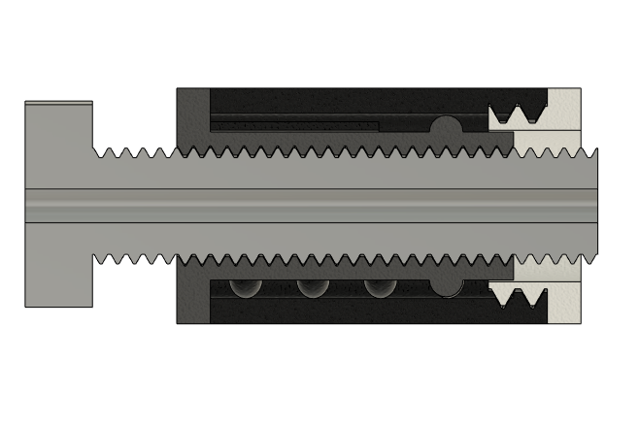
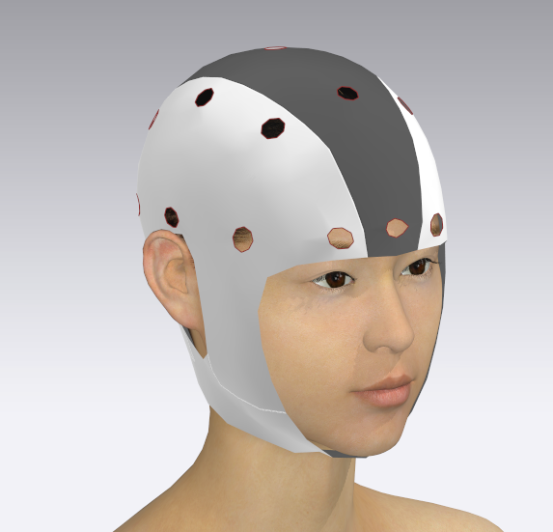
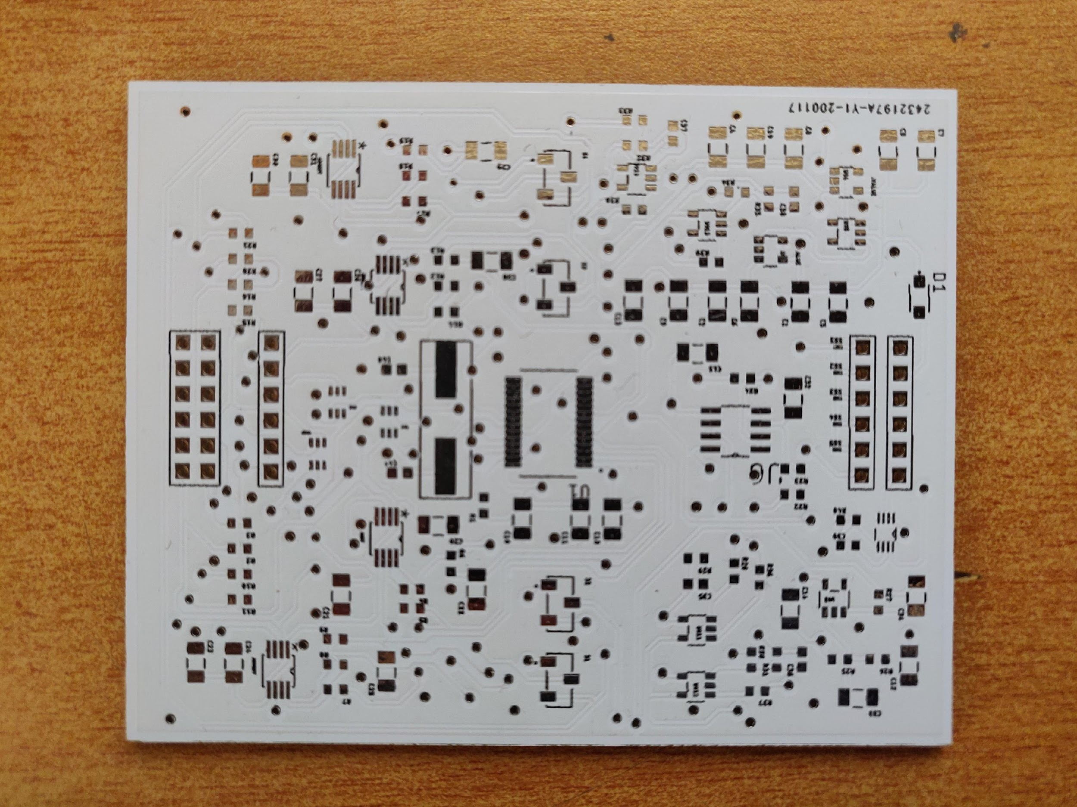
Results

Slide 12

Future Work
Implementing a cap which is washable and can last long.
Flexible to position the electrodes precisely.
The acquisition circuit can be miniaturised which helps in scalability and reduces space of the system.
Adding a microcontroller, transceiver and battery module.

Slide 13
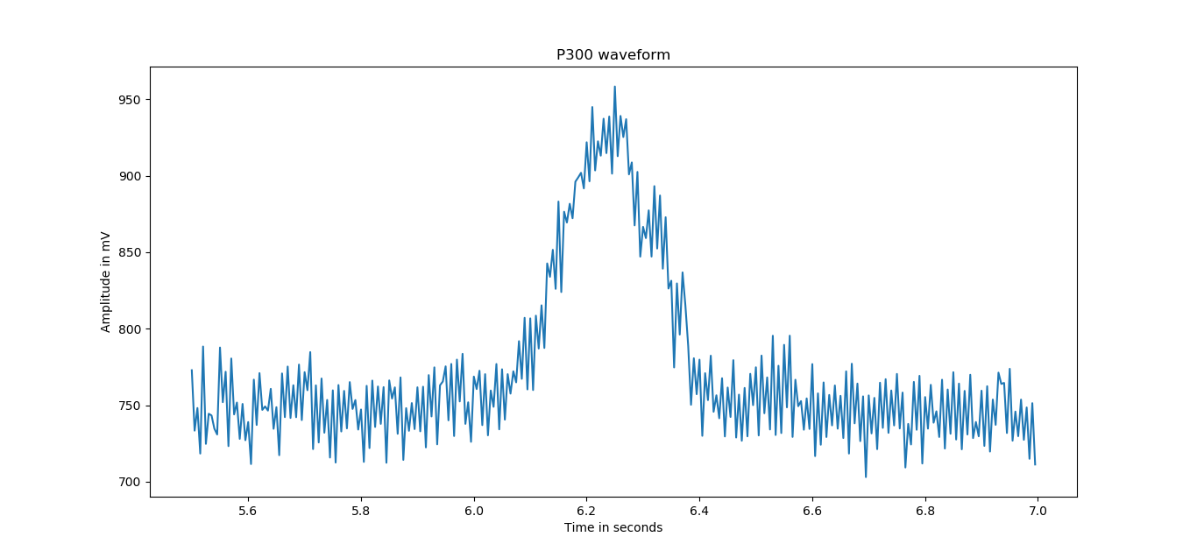
Error-Related Negativity potentials are perturbations of the EEG following an erroneous or unusual event in the subject’s environment or task
The
P300 ERP is one of the strongest neural signatures observable by EEG, especially when targets
are presented infrequently
P300
Speller
Observed over the parietal cortex, the P300 waveform is a large positive deflection of electrical activity observed approximately 300 ms post stimulus onset, the strength of the observed deflection being inversely proportional to the frequency of the target stimuli
This paradigm helps to spell the words displayed on the screen for the user by recording the EEG signals from the user and identifying the correct word on the screen

Slide 14
Software
Choosing a suitable paradigm
Acquiring data for the paradigm
Develop an error detection algorithm using Deep Learning for improving performance of BCI
Objectives

Slide 15
Need For The Study
Exploring EEG applications like P300 Speller

Slide 16
Literature Review
Author | Research paper title | The methodology incorporated in the paper | What we implemented from the paper
Vernon J. Lawhern et al., (2018) [1] | EEGNet: A Compact Convolutional Neural Network for EEG-based Brain-Computer Interfaces | A compact CNN architecture – EEGNet that accurately classifies EEG signals from various BCI paradigms. Incorporated 2D Convolution, Depthwise convolution and Separable convolution. | Incorporated 2D Convolution, Depthwise convolution and Separable convolution.
Perrin Margaux et al., (2012) [2] | Objective and Subjective Evaluation of Online Error Correction during P300-Based Spelling | P300 error detection and automatic correction using mixture of multidimensional Gaussian model as a classifier. | Implemented signal processing specifications and feedback based error corrections for P300 task paradigms.
Nicholas Waytowich et al., (2018) [3] | Compact convolutional neural networks for classification of asynchronous steady-state visual evoked potentials | Combined CCA(Canonical Correlation Analysis) – Compact CNN and multivariate statistical analysis technique | Efficient extraction of frequency-specific spatial filters. Reducing number of trainable parameters to fit.

Slide 17
Literature Review
Author | Research paper title | The methodology incorporated in the paper | What we implemented from the paper
Cheng Liu et al., (2018) [6] | Automatic sleep stage classification on raw single-channel EEG | A deep learning model called ResSleepNet is used for automatic sleep stage scoring based on raw single-channel EEG. | Automatic feature learning technique from EEG channel is implemented.
Heekyung Yang et al., (2019) [7] | A multi-column CNN- based model for emotion reognition from EEG signals. | A multi-column CNN based structured model by producing a weighted sum of the decisions from individual recognizing modules. | Implementated preprocessing techniques such as filtering used for EEG signals.
Craik, Alexander et al., (2019) [8] | Deep learning for electroencephalogram (EEG) classification tasks | Robust automatic classification using deep learning architecture, preprocessing methods and input type. For each type of task specific input formulation, major characteristics, and end classifier recommendations are considered. | Implemented preprocessing methods and specific input formulation.

Slide 18
01
Acquire the EEG signals/ Use an open source Dataset that satisfies the user requirement
Software design flowchart
02
Perform pre-processing steps such as bandpass filtering
03
Create suitable deep learning model to run on data
04
Evaluate the results and analyze the outputs

Slide 19
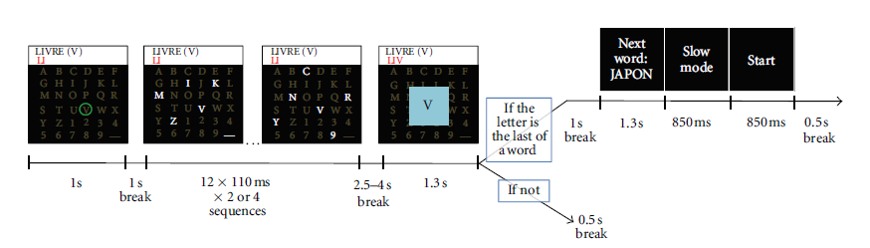
Experimental
Design
Green circle indicates the target letter for 1s after which a 1s break is given. A group of 6 letters are flashed for 4s. After a delay, the output of P300 speller is displayed as feedback for 1.3s. If the letter is the last letter of a word, a 4.5s break is given during which next word is displayed along with the complexity level (slow or fast mode). If not, a 0.5s break is given after which next target green circle letter is displayed on the screen.

Slide 20
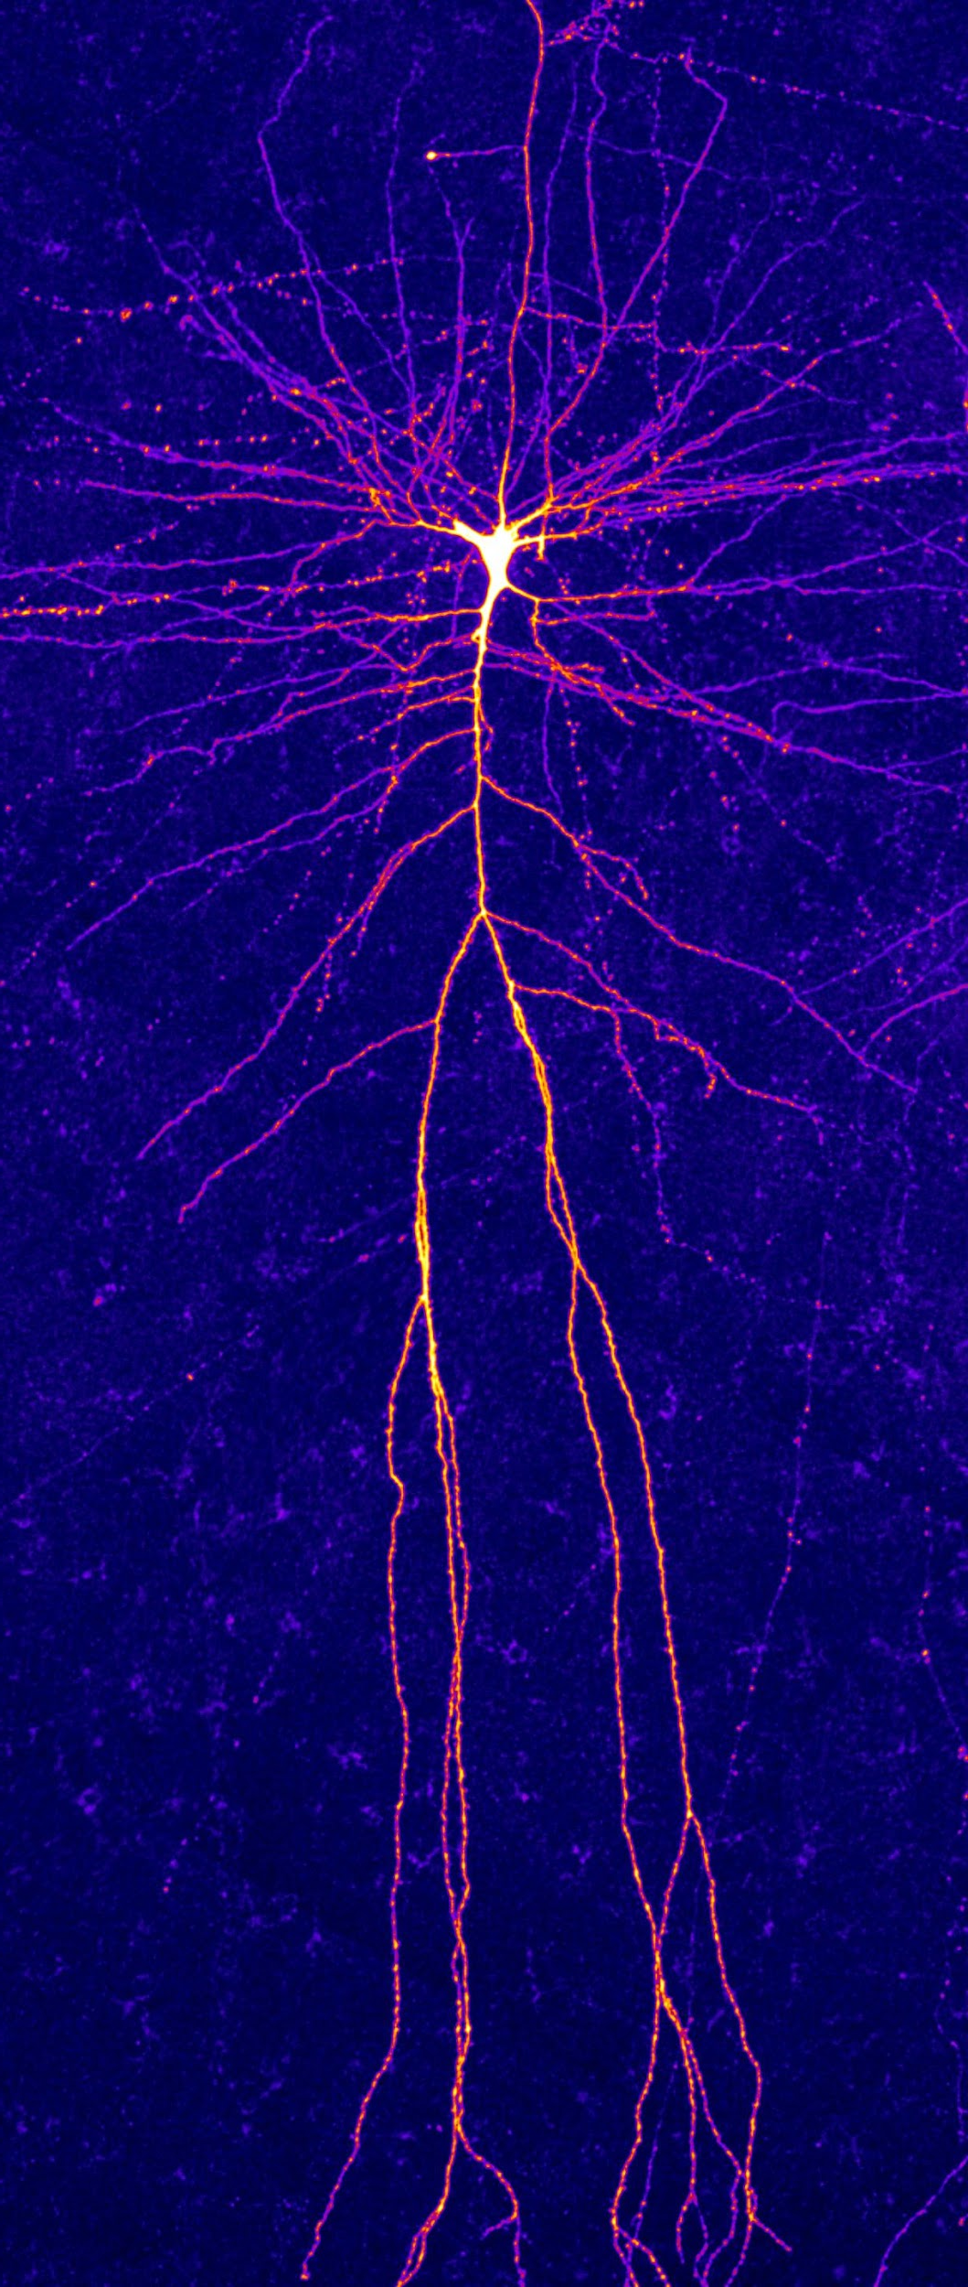
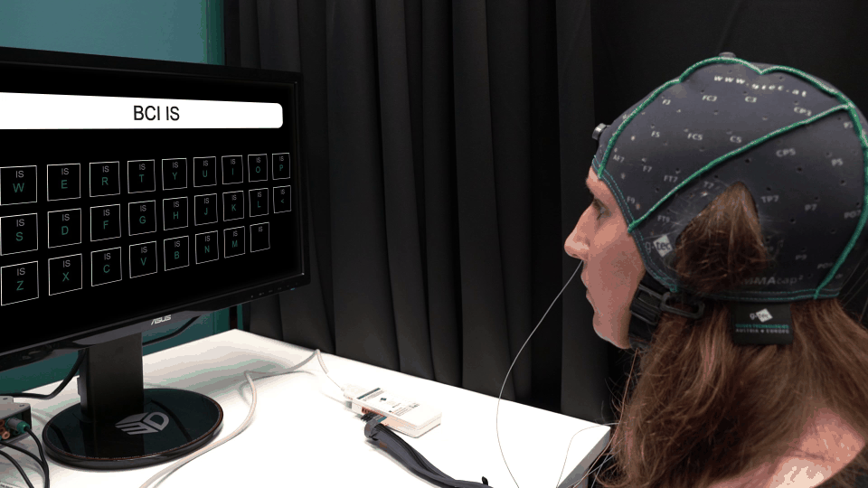
Data set description
KAGGLE - BCI Challenge @ NER 2015
In this competition, participants are asked to submit an Error Potential detection algorithm, capable of detecting the erroneous feedbacks online
26 Subjects
16 – Training
10- Testing
(13 male, mean age = 28.8±5.4 (SD), range 20-37)
The subjects had to go through five copy spelling sessions. Each session consisted of twelve 5-letter words, except the fifth which consisted of twenty 5-letter words.
Subject’s brain activity was recorded with 56 passive Ag/AgCl EEG sensors (VSM-CTF compatible system) whose placement followed the extended 10-20 system

Slide 21
Steps in preprocessing

Slide 22
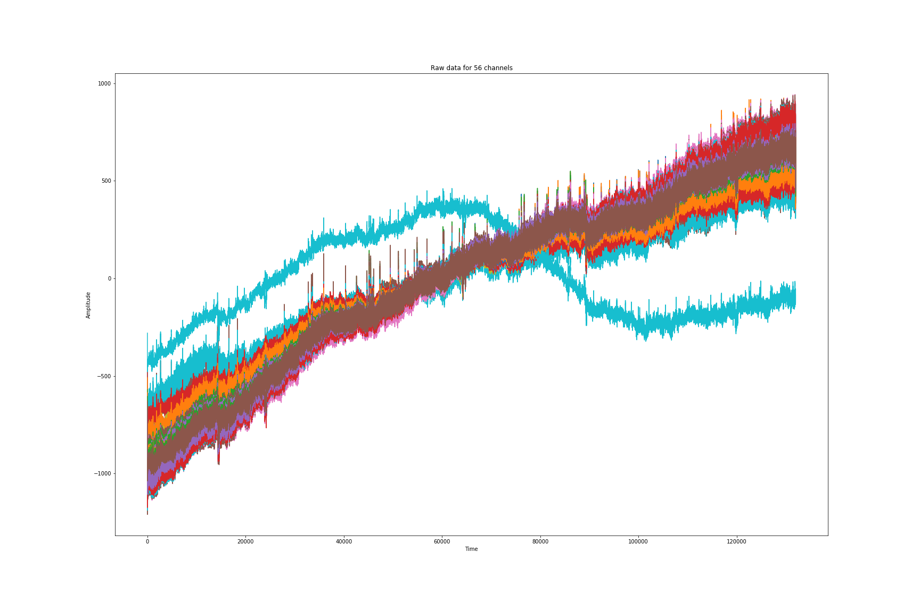
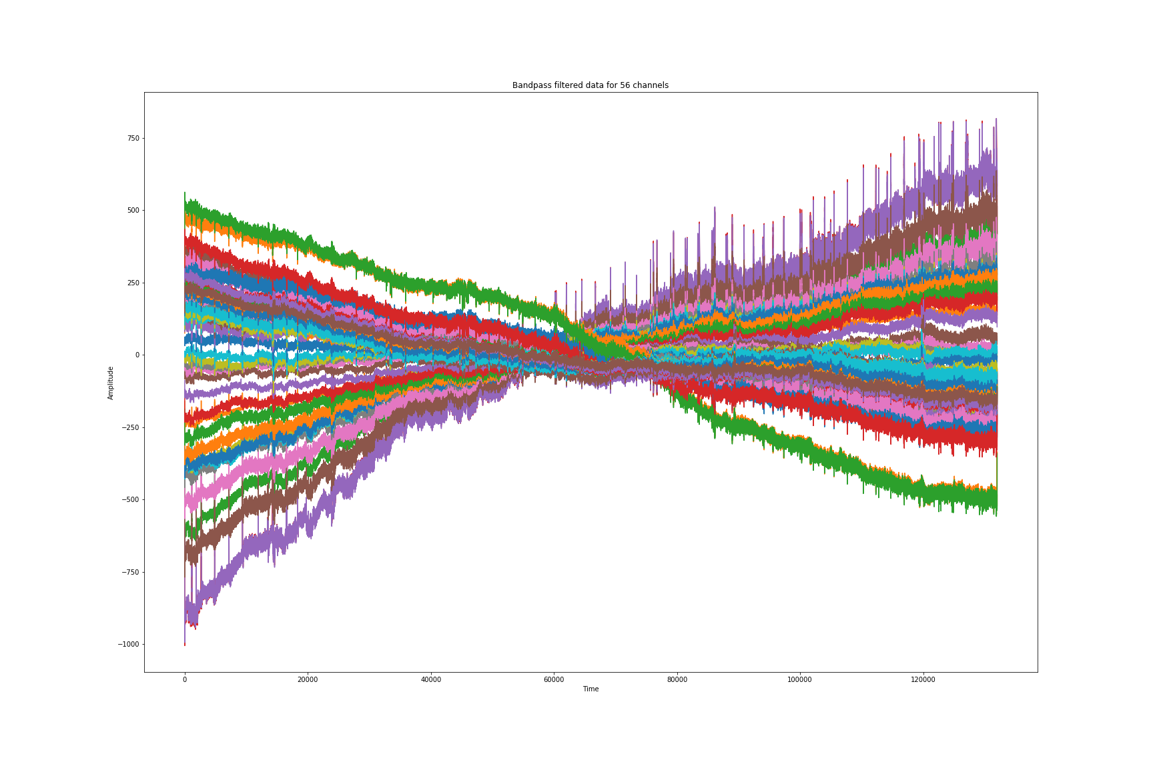
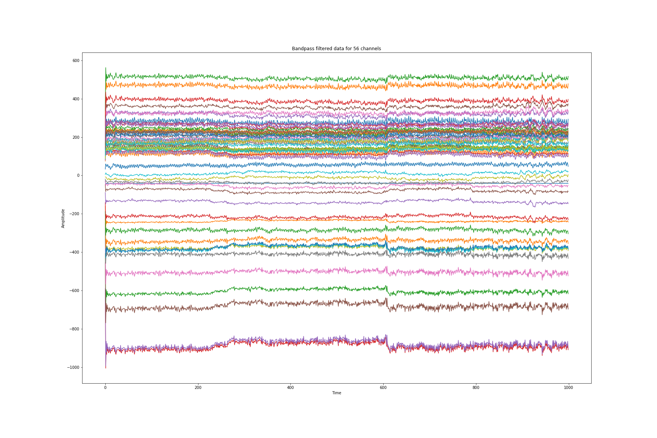
Steps in preprocessing
Bandpass Filtering:
Butterworth BP filter with passband 1-40 Hz
Down sampling:
Data was down sampled from 200 to 128 Hz
01
02
03
Data Slicing:
Timepoints were extracted according to feedback response

Slide 23
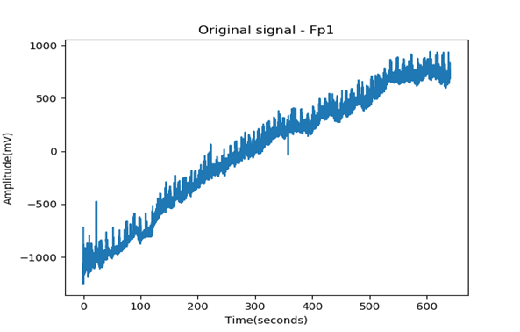
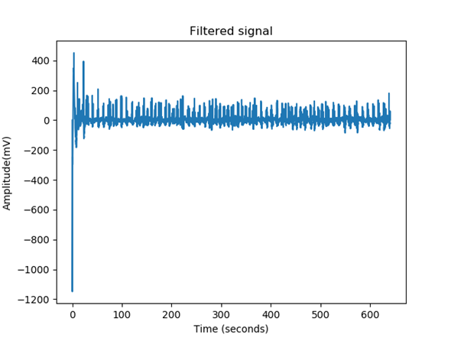
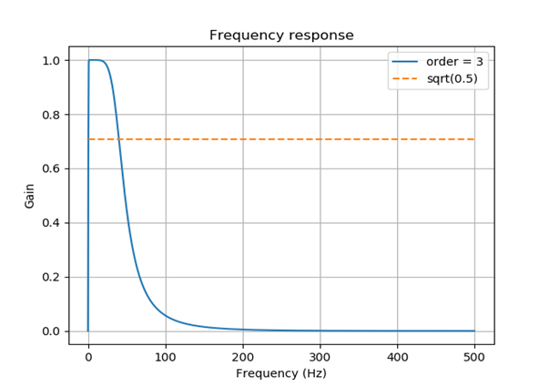

Slide 24
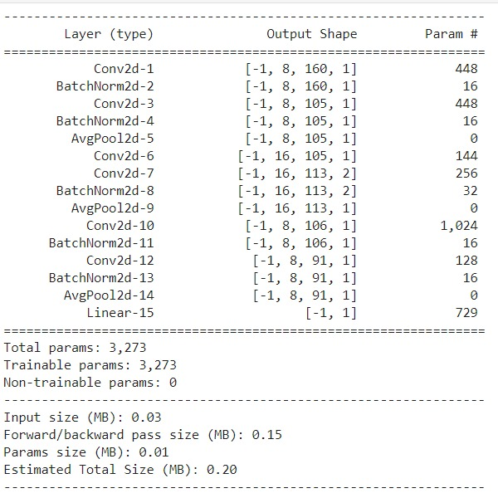
Deep Learning Model
We have designed a 15-layer Convolutional Neural network model for feature extraction and classification
The model is influenced by the work of EEGNET by Lawhern, Vernon J et al. “EEGNet: a Compact Convolutional Neural Network for EEG-Based Brain–computer Interfaces.” Journal of Neural Engineering 15.5 (2018): 056013. Crossref. Web.
Similar to this paper, we have employed the use of depth wise and separable convolutions operations.
The model takes as input a batch of 100 samples each of size TxC where T = timepoints, C = Channels

Slide 25

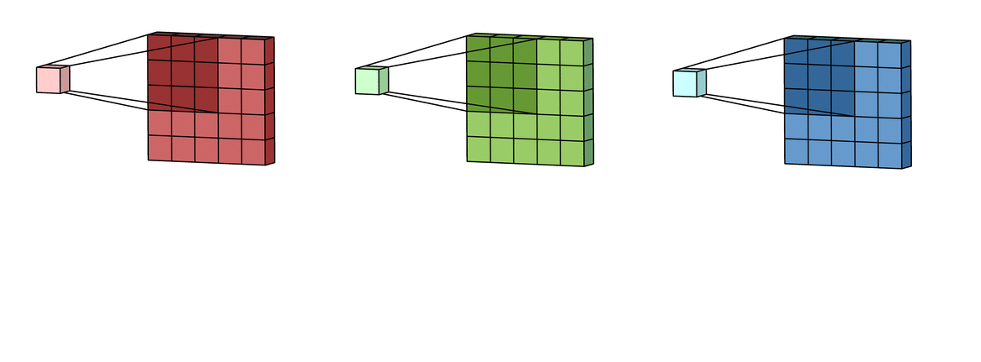
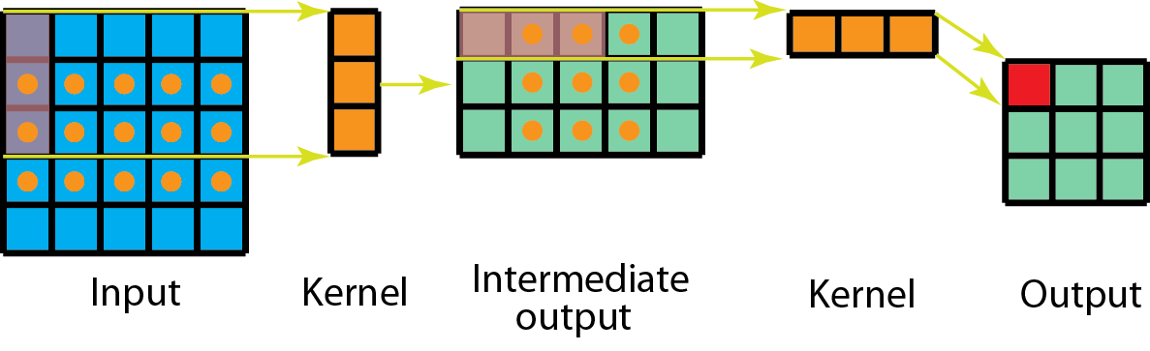
Our decision to implement Depthwise and Separable convolutions was inspired by the fact that these convolution operations are similar to a normal convolution but require fewer parameters to train.
The use of Depthwise convolutions was similar to the process of spatial filtering in signal processing while Separable convolutions are similar to decoupling filters that help aggregate individual filters while combining optimal filters
In our model, we first apply convolutional kernels as temporal filters of size (1,56) followed by bath normalization.
We then add a depthwise convolution layer of (56,1) for every channel. This is again followed by batch normalization
Further, we add a separable layer with kernel size of (1,8) to learn individual summaries of the features obtained and combine the outputs

Slide 26
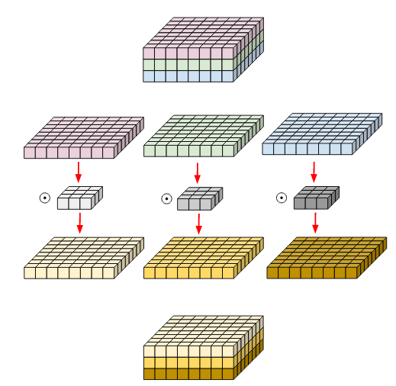
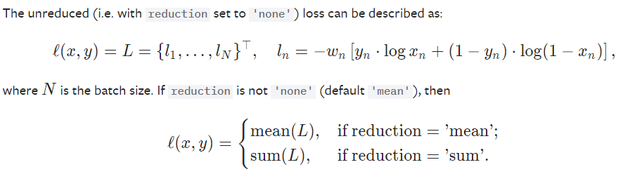
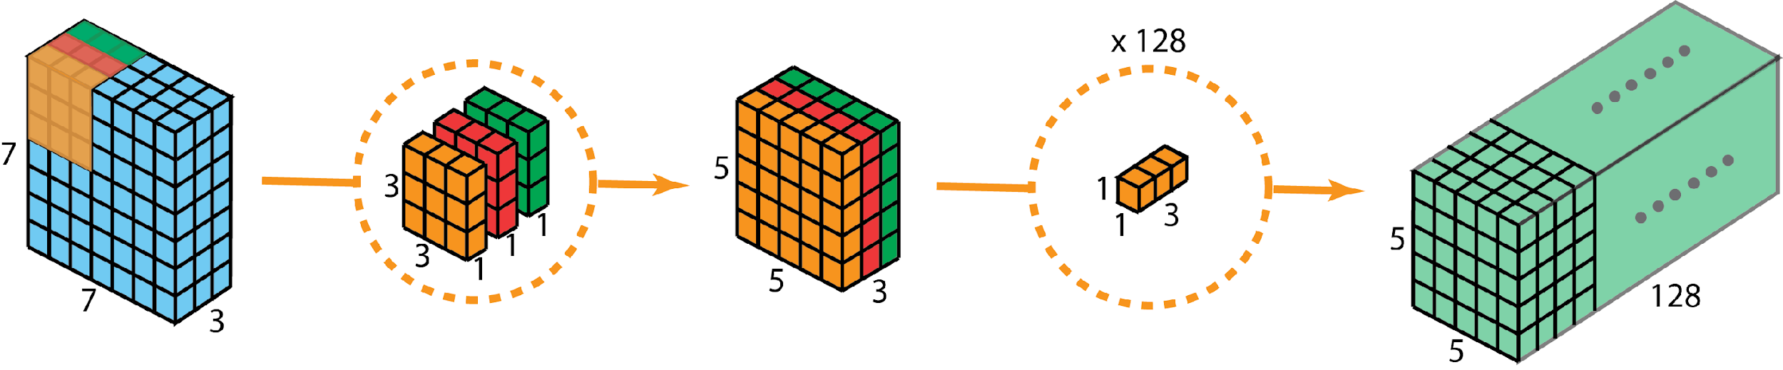
This is then fed to a fully connected layer with a sigmoid activation that predicts whether the output is correct or incorrect
The loss function selected was the Binary Cross entropy loss
The optimizer used was Adam with weight decay with a learning rate of 0.001 and beta values (0.9,0.999) and weight decay of 0.01
Left: Depthwise Convolution Bottom: Separable Convolution

Slide 27

Results
Metric | Our Model Training Set N = 3180 Balanced | Our Model Test Set N = 3400 Unbalanced | EEGNET Test Set N = 3400 Unbalanced
AUC | 0.9457 | 0.5743 | 0.5274
Accuracy | 0.8781 | 0.5794 | 0.5283
F-measure | 0.8802 | 0.6745 | 0.5457
Precision | 0.9039 | 0.7473 | 0.5945
Recall | 0.8576 | 0.6148 | 0.5283
The model is displaying high variance on the test set compared to the training set and thus there is a reduction in AUC and accuracy. This is also because the test set contains unbalanced classes whose information was not given. This problem can be solved by retraining the model to fit the distribution on the test set or by simply collecting more data and training the algorithm again.
The code has been hosted with all files on https://github.com/adwaykanhere/FYP

Slide 28
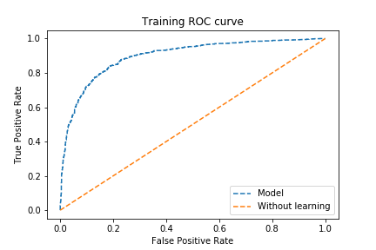
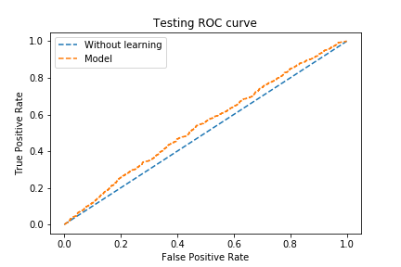
Metric | Our Model Training Set N = 3180 Balanced | Our Model Test Set N = 3400 Unbalanced | EEGNET Test Set N = 3400 Unbalanced
AUC | 0.9457 | 0.5743 | 0.5274
Accuracy | 0.8781 | 0.5794 | 0.5283
F-measure | 0.8802 | 0.6745 | 0.5457
Precision | 0.9039 | 0.7473 | 0.5945
Recall | 0.8576 | 0.6148 | 0.5283
Results

Slide 29
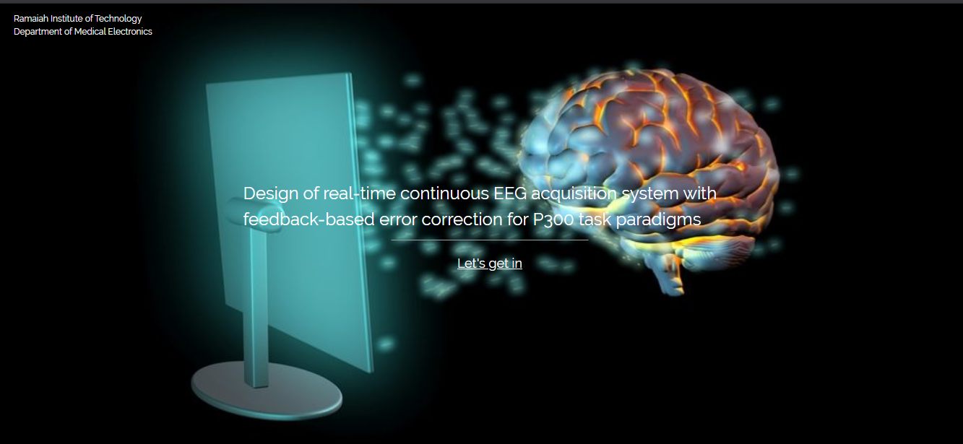

DEMO - GUI Web App

Slide 30
Future Work
Signal processing using higher order filters which removes noise
Hyper-parameter tuning and using regularizer to increase the accuracy
Using hybrid models (CNN+RNN) can improve the accuracy and AUC

Slide 31
Contributions
1MS16ML001 Adway Kanhere | 1MS16ML022 Jigyans Kranti Mohapatra | 1MS16ML034 Prajna G Hardikar | 1MS16ML053 T H Greeshma
Design of EEG processing and pre-processing workflow, EEG Exploratory data analysis for Kaggle dataset and BCI competition dataset Researched deep learning applications to EEG datasets, Coded deep learning algorithm in Python and Pytorch Creating a modular and systematic workflow for data loading and model running to provide results by implementing EEG feature explain ability. | Schematic Design in Autodesk Eagle ESD Protection Design Power Supply Design ADC ERC Check Component Selection Board Design in Autodesk Eagle DRC Check Board Fabrication Supplier search Cap Version 1 and 2 Design in CLO Cap 1 Fabrication Electrode Dock Design in Autodesk Fusion 360 | Worked on electrode design and construction Investigated various EEG signal processing technique Explored different filters for noise removal and baseline wandering Implemented IIR Bandpass filter Implemented EEGNet model GUI- Web App Implementation using flask | Soldering of components to the signal acquisition board. Explored various electrodes against the standard electrode.

Slide 32
References
[1] Lawhern, Vernon J et al. “EEGNet: a Compact Convolutional Neural Network for EEG-Based Brain–computer Interfaces.” Journal of Neural Engineering 15.5 (2018): 056013. Crossref. Web.
[2] Margaux, Perrin, et al. "Objective and subjective evaluation of online error correction during P300-based spelling." Advances in Human-Computer Interaction 2012 (2012).
[3] Nicholas R Waytowich et al. “Compact convolutional neural networks for classification of asynchronous steady-state visual evoked potentials”. Journal of Neural Engineering (2018)
[4] Kim, Tae Ann, et al. "Single-walled carbon nanotube/silicone rubber composites for compliant electrodes." Carbon 50.2 (2012): 444-449.
[5] Pungor, E., and É. Szepesváry. "Voltammetric studies with silicone rubber-based graphite electrodes." Analytica Chimica Acta 43 (1968): 289-296.
[6] Supratak, Akara et al. “DeepSleepNet: A Model for Automatic Sleep Stage Scoring Based on Raw Single-Channel EEG.” IEEE Transactions on Neural Systems and Rehabilitation Engineering 25.11 (2017): 1998–2008. Crossref. Web.
[7] Yang, Heekyung et al. “A Multi-Column CNN Model for Emotion Recognition from EEG Signals.” Sensors (Basel, Switzerland) vol. 19,21 4736. 31 Oct. 2019, doi:10.3390/s19214736
[8] Craik, Alexander, Yongtian He, and Jose L. Contreras-Vidal. "Deep learning for electroencephalogram (EEG) classification tasks: a review." Journal of neural engineering 16.3 (2019): 031001.
We would like to thank Dr Mahendra, MSRMC for his valuable time and inputs.

